Slide 1
What is a Firewall?
a choke point of control and monitoring
interconnects networks with differing trust
imposes restrictions on network services
  only authorized traffic is allowed
auditing and controlling access
  can implement alarms for abnormal behavior
provide NAT & usage monitoring
implement VPNs using IPSec
must be immune to penetration
Notes:
A firewall is inserted between the premises network and the Internet to establish a controlled link and to erect an outer security wall or perimeter, forming a single choke point where security and audit can be imposed. A firewall:
defines a single choke point that keeps unauthorized users out of the protected network, prohibits potentially vulnerable services from entering or leaving the network, and provides protection from various kinds of IP spoofing and routing attacks.
2. provides a location for monitoring security-related events
3. is a convenient platform for several Internet functions that are not security related, such as NAT and Internet usage audits or logs
4. A firewall can serve as the platform for IPSec to implement virtual private networks.
The firewall itself must be immune to penetration, since it will be a target of attack.

Slide 2
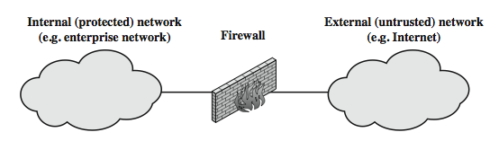
What is a Firewall?
Notes:
Stallings Figure 11.1a illustrates the general model of firewall use on the security perimeter, as a choke point for traffic between between the external less-trusted Internet and the internal more trusted private network.

Slide 3
Firewall Limitations
cannot protect from attacks bypassing it
  eg sneaker net, utility modems, trusted organisations, trusted services (eg SSL/SSH)
cannot protect against internal threats
  eg disgruntled or colluding employees
cannot protect against access via WLAN
  if improperly secured against external use
cannot protect against malware imported via laptop, PDA, storage infected outside
Notes:
Firewalls have their limitations, including that they:
1. cannot protect against attacks that bypass the firewall, eg PCs with dial-out capability to an ISP, or dial-in modem pool use
2. do not protect against internal threats, eg disgruntled employee or one who cooperates with an attacker
3. An improperly secured wireless LAN may be accessed from outside the organization. An internal firewall that separates portions of an enterprise network cannot guard against wireless communications between local systems on different sides of the internal firewall.
4. A laptop, PDA, or portable storage device may be used and infected outside the corporate network, and then attached and used internally.

Slide 4
Firewalls Types
Packet Filters
simplest, fastest firewall component
foundation of any firewall system
examine each IP packet (no context) and permit or deny according to rules
hence restrict access to services (ports)
possible default policies
  that not expressly permitted is prohibited
  that not expressly prohibited is permitted
Notes:
Have three common types of firewalls: packet filters, application-level gateways, & circuit-level gateways.
A packet-filtering router applies a set of rules to each incoming and outgoing IP packet to forward or discard the packet. Filtering rules are based on information contained in a network packet such as src & dest IP addresses, ports, transport protocol & interface. Some advantages are simplicity, transparency & speed.
If there is no match to any rule, then one of two default policies are applied:
• that which is not expressly permitted is prohibited (default action is discard packet), conservative policy
• that which is not expressly prohibited is permitted (default action is forward packet), permissive policy

Slide 5
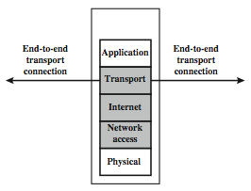
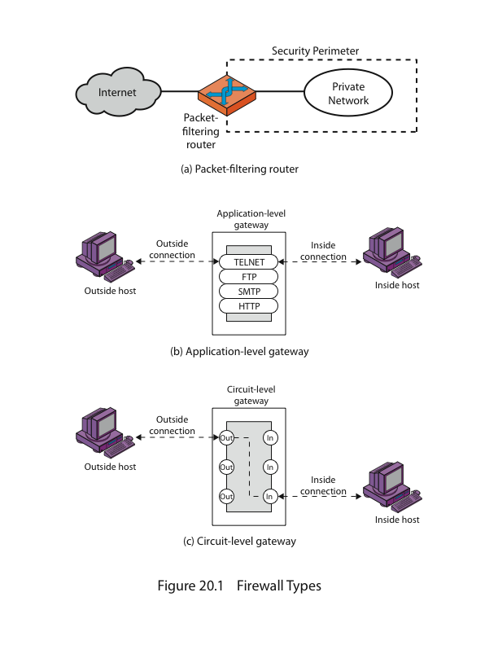
Firewalls – Packet Filters
Notes:
Figure illustrates the packet filter firewall role as utilising information from the transport, network & data link layers to make decisions on allowable traffic flows, and its placement in the border router between the external less-trusted Internet and the internal more trusted private network.

Slide 6
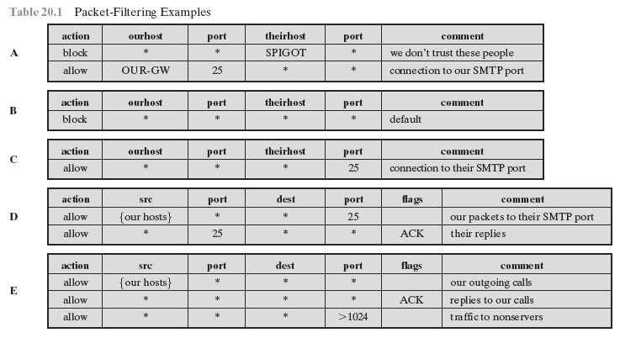
Firewalls – Packet Filters
Notes:
Table gives some examples of packet-filtering rule sets. In each set, the rules are applied top to bottom.
A. Inbound mail is allowed to a gateway host only (port 25 is for SMTP incoming
B. explicit statement of the default policy
C. tries to specify that any inside host can send mail to the outside, but has problem that an outside machine could be configured to have some other application linked to port 25
D. properly implements mail sending rule, by checking ACK flag of a TCP segment is set
E. this rule set is one approach to handling FTP connections

Slide 7
Attacks on Packet Filters
IP address spoofing
  fake source address to be trusted
  add filters on router to block
source routing attacks
  attacker sets a route other than default
  block source routed packets
tiny fragment attacks
  split header info over several tiny packets
  either discard or reassemble before check
Notes:
Some of the attacks that can be made on packet-filtering routers & countermeasures are:
• IP address spoofing: where intruder transmits packets from the outside with internal host source IP addr, need to filter & discard such packets
• Source routing attacks: where source specifies the route that a packet should take to bypass security measures, should discard all source routed packets
• Tiny fragment attacks: intruder uses the IP fragmentation option to create extremely small fragments and force the TCP header information into a separate fragments to circumvent filtering rules needing full header info, can enforce minimum fragment size to include full header.

Slide 8
Firewalls – Stateful Packet Filters
traditional packet filters do not examine higher layer context
  ie matching return packets with outgoing flow
stateful packet filters address this need
they examine each IP packet in context
  keep track of client-server sessions
  check each packet validly belongs to one
hence are better able to detect bogus packets out of context
may even inspect limited application data
Notes:
A traditional packet filter makes filtering decisions on an individual packet basis and does not take into consideration any higher layer context. In general, when an application that uses TCP creates a session with a remote host, it creates a TCP connection in which the TCP port number for the remote (server) application is a number less than 1024 and the TCP port number for the local (client) application is a number between 1024 and 65535. A simple packet filtering firewall must permit inbound network traffic on all these high- numbered ports for TCP-based traffic to occur. This creates a vulnerability that can be exploited by unauthorized users. A stateful inspection packet filter tightens up the rules for TCP traffic by creating a directory of outbound TCP connections, and will allow incoming traffic to high-numbered ports only for those packets that fit the profile of one of the entries in this directory. Hence they are better able to detect bogus packets sent out of context. A stateful packet inspection firewall reviews the same packet information as a packet filtering firewall, but also records information about TCP connections. Some stateful firewalls also keep track of TCP sequence numbers to prevent attacks that depend on the sequence number, such as session hijacking. Some even inspect limited amounts of application data for some well-known protocols like FTP, IM and SIPS commands, in order to identify and track related connections.

Slide 9
Firewalls - Application Level Gateway (or Proxy)
have application specific gateway / proxy
has full access to protocol
  user requests service from proxy
  proxy validates request as legal
  then actions request and returns result to user
  can log / audit traffic at application level
need separate proxies for each service
  some services naturally support proxying
  others are more problematic
Notes:
An application-level gateway (or proxy server), acts as a relay of application-level traffic. A user contacts the gateway to access some service, provides details of the service, remote host & authentication details, contacts the application on the remote host and relays all data between the two endpoints. If the gateway does not implement the proxy code for a specific application, then it is not supported and cannot be used. Note that some services naturally support proxying, whilst others are more problematic. Application-level gateways tend to be more secure than packet filters, &can log and audit traffic at application level.

Slide 10
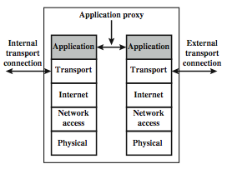
Firewalls - Application Level Gateway (or Proxy)
Notes:
Figure illustrates an application-level gateway (or proxy server), emphasizing that it only supports a specific list of application services.

Slide 11
Firewalls - Circuit Level Gateway
relays two TCP connections
imposes security by limiting which such connections are allowed
once created usually relays traffic without examining contents
typically used when trust internal users by allowing general outbound connections
SOCKS is commonly used
Notes:
A fourth type of firewall is the circuit-level gateway or circuit-level proxy. This can be a stand-alone system or it can be a specialized function performed by an application-level gateway for certain applications. A circuit-level gateway relays two TCP connections, one between itself and an inside TCP user, and the other between itself and a TCP user on an outside host. Once the two connections are established, it relays TCP data from one connection to the other without examining its contents. The security function consists of determining which connections will be allowed. It is typically used when internal users are trusted to decide what external services to access.
One of the most common circuit-level gateways is SOCKS, defined in RFC 1928. It consists of a SOCKS server on the firewall, and a SOCKS library & SOCKS-aware applications on internal clients. When a TCP-based client wishes to establish a connection to an object that is reachable only via a firewall (such determination is left up to the implementation), it must open a TCP connection to the appropriate SOCKS port on the SOCKS server system. If the connection request succeeds, the client enters a negotiation for the authentication method to be used, authenticates with the chosen method, and then sends a relay request. The SOCKS server evaluates the request and either establishes the appropriate connection or denies it. UDP exchanges are handled in a similar fashion.

Slide 12
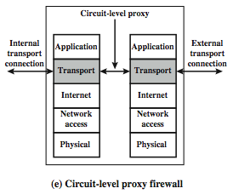
Firewalls - Circuit Level Gateway
Notes:
Stallings Figure 11.1e (along with 4/e Figure 20.1c) illustrates a circuit-level gateway, showing how it relays between 2 TCP connections. Note that it can be implemented in a stand-alone system or can be a specialized function in an application-level gateway for certain applications. Note also that relaying UDP packets is more problematical, because of the lack of connection context, and require a parallel TCP connection to provide these details.

Slide 13
Bastion Host
highly secure host system
runs circuit / application level gateways
or provides externally accessible services
potentially exposed to "hostile" elements
hence is secured to withstand this
  hardened O/S, essential services, extra auth
  proxies small, secure, independent, non-privileged
may support 2 or more net connections
may be trusted to enforce policy of trusted separation between these net connections
Notes:
It is common to base a firewall on a stand-alone machine running a common operating system, such as UNIX or Linux. Firewall functionality can also be implemented as a software module in a router or LAN switch.
A bastion host is a critical strong point in the network’s security, serving as a platform for an application-level or circuit-level gateway, or for external services. It is thus potentially exposed to "hostile" elements and must be secured to withstand this. Common characteristics of a bastion host include that it:
• executes a secure version of its O/S, making it a trusted system
• has only essential services installed on the bastion host
• may require additional authentication before a user may access to proxy services
• configured to use only subset of standard commands, access only specific hosts
• maintains detailed audit information by logging all traffic
• each proxy module a very small software package designed for network security
• has each proxy independent of other proxies on the bastion host
• have a proxy performs no disk access other than read its initial configuration file
• have each proxy run as a non-privileged user in a private and secured directory
A bastion host may have two or more network interfaces (or ports), and must be trusted to enforce trusted separation between these network connections, relaying traffic only according to policy.

Slide 14
Host-Based Firewalls
s/w module used to secure individual host
  available in many operating systems
  or can be provided as an add-on package
often used on servers
advantages:
  can tailor filtering rules to host environment
  protection is provided independent of topology
  provides an additional layer of protection
Notes:
A host-based firewall is a software module used to secure an individual host. Such modules are available in many operating systems or can be provided as an add-on package. Like conventional stand-alone firewalls, host-resident firewalls filter and restrict the flow of packets. A common location for such firewalls is a server. There are several advantages to the use of a server-based or workstation-based firewall:
• Filtering rules can be tailored to the host environment. Specific corporate security policies for servers can be implemented, with different filters for servers used for different application.
• Protection is provided independent of topology. Thus both internal and external attacks must pass through the firewall.
• Used in conjunction with stand-alone firewalls, the host-based firewall provides an additional layer of protection. A new type of server can be added to the network, with its own firewall, without the necessity of altering the network firewall configuration.

Slide 15
Personal Firewalls
controls traffic between PC/workstation and Internet or enterprise network
a software module on personal computer
or in home/office DSL/cable/ISP router
typically much less complex than other firewall types
primary role to deny unauthorized remote access to the computer
and monitor outgoing activity for malware
Notes:
A personal firewall controls the traffic between a personal computer or workstation on one side and the Internet or enterprise network on the other side. Personal firewall functionality can be used in the home environment and on corporate intranets. Typically, the personal firewall is a software module on the personal computer. In a home environment with multiple computers connected to the Internet, firewall functionality can also be housed in a router that connects all of the home computers to a DSL, cable modem, or other Internet interface.
Personal firewalls are typically much less complex than either server-based firewalls or stand-alone firewalls. The primary role of the personal firewall is to deny unauthorized remote access to the computer. The firewall can also monitor outgoing activity in an attempt to detect and block worms and other malware.

Slide 16
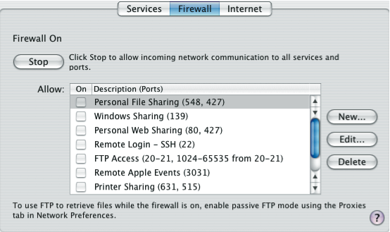
Personal Firewalls
Notes:
An example of a personal firewall is the capability built in to the Mac OS X operating system. When the user enables the personal firewall in Mac OS X, all inbound connections are denied except for those the user explicitly permits. Figure shows this simple interface. There is a list of inbound services that can be selectively re-enabled, with their port numbers. For increased protection, advanced firewall features are available through easy-to- configure checkboxes. Stealth mode hides the Mac on the Internet by dropping unsolicited communication packets, making it appear as though no Mac is present. UDP packets can be blocked, restricting network traffic to TCP packets only for open ports. The firewall also supports logging, an important tool for checking on unwanted activity.
Similar features are provided by the firewalls provided in Windows and Linux systems.

Slide 17
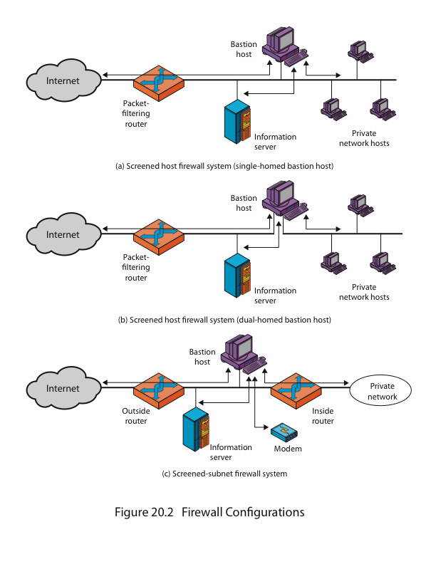
Firewall Configurations
Notes:
As Figure indicates, a firewall is positioned to provide a protective barrier between an external, potentially untrusted source of traffic and an internal network. With that general principle in mind, a security administrator must decide on the location and on the number of firewalls needed.
In addition to the use of a simple configuration consisting of a single system, more complex configurations are possible and indeed more common. Stallings 4/e Figure 20.2 illustrates three common firewall configurations.
Figure shows the “screened host firewall, single-homed bastion configuration”, where the firewall consists of two systems:
a packet-filtering router - allows Internet packets to/from bastion only
a bastion host - performs authentication and proxy functions
This configuration has greater security, as it implements both packet-level & application-level filtering, forces an intruder to generally penetrate two separate systems to compromise internal security, & also affords flexibility in providing direct Internet access to specific internal servers (eg web) if desired.

Slide 18
Firewall Configurations
Notes:
Stallings 4/e Figure 20.2b illustrates the “screened host firewall, dual-homed bastion configuration” which physically separates the external and internal networks, ensuring two systems must be compromised to breach security. The advantages of dual layers of security are also present here. Again, an information server or other hosts can be allowed direct communication with the router if this is in accord with the security policy, but are now separated from the internal network.

Slide 19
Firewall Configurations
Notes:
Figure shows the “screened subnet firewall configuration”, being the most secure shown. It has two packet-filtering routers, one between the bastion host and the Internet and the other between the bastion host and the internal network, creating an isolated subnetwork. This may consist of simply the bastion host but may also include one or more information servers and modems for dial-in capability. Typically, both the Internet and the internal network have access to hosts on the screened subnet, but traffic across the screened subnet is blocked.
This configuration offers several advantages:
• There are now three levels of defense to thwart intruders
• The outside router advertises only the existence of the screened subnet to the Internet; therefore the internal network is invisible to the Internet
• Similarly, the inside router advertises only the existence of the screened subnet to the internal network; hence systems on the inside network cannot construct direct routes to the Internet

Slide 20
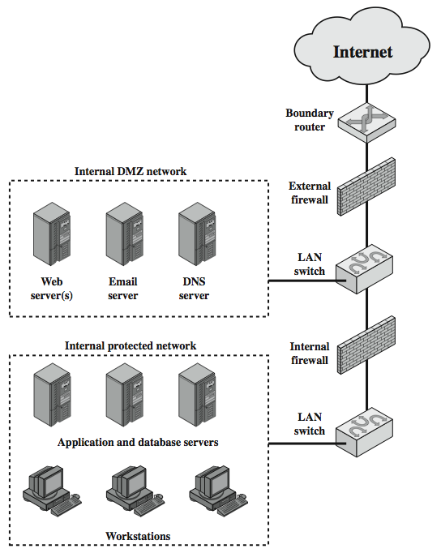
DMZ Networks
Notes:
Figure further illustrates the use of a “screened subnet”, also known as a demilitarized zone (DMZ), located between an internal and an external firewall. An external firewall is placed at the edge of a local or enterprise network, just inside the boundary router that connects to the Internet or some wide area network (WAN). One or more internal firewalls protect the bulk of the enterprise network. Systems that are externally accessible but need some protections are usually located on DMZ networks. Typically, the systems in the DMZ require or foster external connectivity, such as a corporate Web site, an e-mail server, or a DNS (domain name system) server. The external firewall provides a measure of access control and protection for the DMZ systems consistent with their need for external connectivity. The external firewall also provides a basic level of protection for the remainder of the enterprise network. In this type of configuration, internal firewalls serve three purposes:
The internal firewall adds more stringent filtering capability, vs the external firewall, to protect enterprise servers and workstations from external attack.
The internal firewall provides two-way protection with respect to the DMZ, as it protects the remainder of the network from attacks launched from DMZ systems, and protects DMZ systems from attack by internal hosts.
Multiple internal firewalls can be used to protect portions of the internal network from each other.
A common practice is to place the DMZ on a different network interface on the external firewall from that used to access the internal networks.

Slide 21
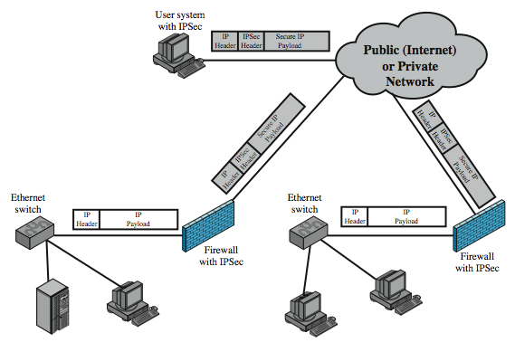
Virtual Private Networks
Notes:
In today's distributed computing environment, the virtual private network (VPN) offers an attractive solution to network managers. The VPN consists of a set of computers that interconnect by means of a relatively unsecure network and that make use of encryption and special protocols to provide security. At each corporate site, workstations, servers, and databases are linked by one or more local area networks (LANs). The Internet or some other public network can be used to interconnect sites, providing a cost savings over the use of a private network and offloading the wide area network management task to the public network provider. That same public network provides an access path for telecommuters and other mobile employees to log on to corporate systems from remote sites.
A logical means of implementing an IPSec is in a firewall, as shown in Stallings Figure 11.4, which essentially repeats Figure 19.1. If IPSec is implemented in a separate box behind (internal to) the firewall, then VPN traffic passing through the firewall in both directions is encrypted. In this case, the firewall is unable to perform its filtering function or other security functions, such as access control, logging, or scanning for viruses. IPSec could be implemented in the boundary router, outside the firewall. However, this device is likely to be less secure than the firewall and thus less desirable as an IPSec platform.

Slide 22
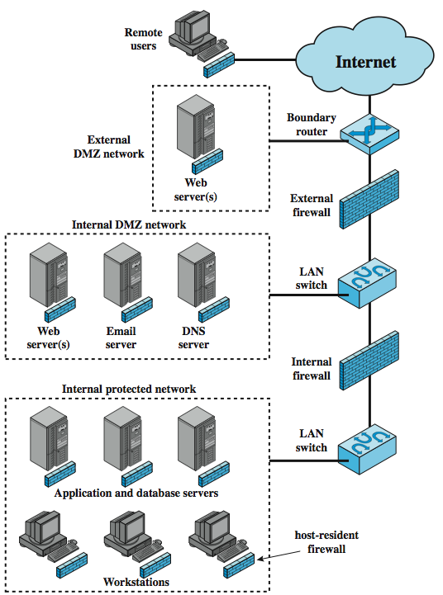
Distributed Firewalls
Notes:
A distributed firewall configuration involves stand-alone firewall devices plus host-based firewalls working together under a central administrative control. Stallings Figure 11.5 suggests a distributed firewall configuration. Administrators can configure host-resident firewalls on hundreds of servers and workstation as well as configure personal firewalls on local and remote user systems. Tools let the network administrator set policies and monitor security across the entire network. These firewalls protect against internal attacks and provide protection tailored to specific machines and applications. Stand-alone firewalls provide global protection, including internal firewalls and an external firewall, as discussed previously. With distributed firewalls, it may make sense to establish both an internal and an external DMZ. Web servers that need less protection because they have less critical information on them could be placed in an external DMZ, outside the external firewall. What protection is needed is provided by host-based firewalls on these servers. An important aspect of a distributed firewall configuration is security monitoring. Such monitoring typically includes log aggregation and analysis, firewall statistics, and fine-grained remote monitoring of individual hosts if needed.

